Slide 1
BASIC JAPANESE LANGUAGE
GLT1031 (WEEK 6)

Slide 2
PREVIOUS CONTENT (WEEK 7)
About topic : | To talk about your favorite food & breakfast
Grammar : | Talk about likes & dislikes (general) Talk about actions such as what one eats or drinks Say how frequently the action is done

Slide 3
復習しましょう・ふくしゅうしましょう
Q1
たべものはなにがすきですか
Q2
あさごはんはなにをたべますか
Q3
よくコーヒーをのみますか

Slide 4
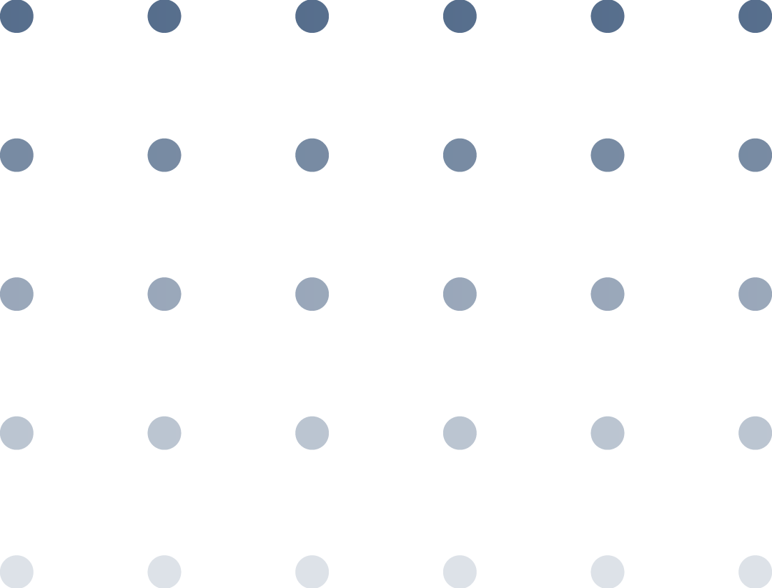

6
しょくどうでひるごはんたべます
I eat lunch at cafeteria

Slide 5
CONTENTS OF THIS LESSON
About topic : | To talk about your favorite dish and where to eat for lunch
Grammar : | Talk about likes & dislikes (specific category) Talk about where one eats or drinks Give opinion, thoughts or description on something

Slide 6
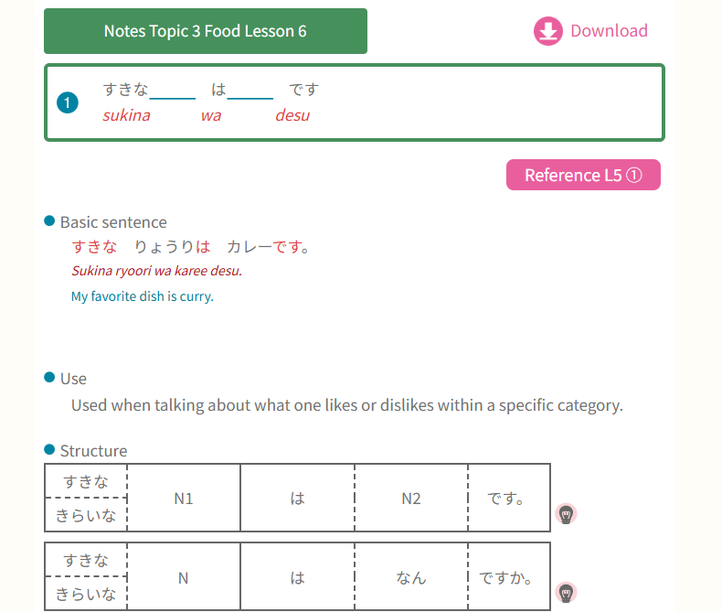
GRAMMAR PART
② Talk about likes & dislike within
specific category
すき (adj) - like
きらい (adj) – hate/dislike

Slide 7
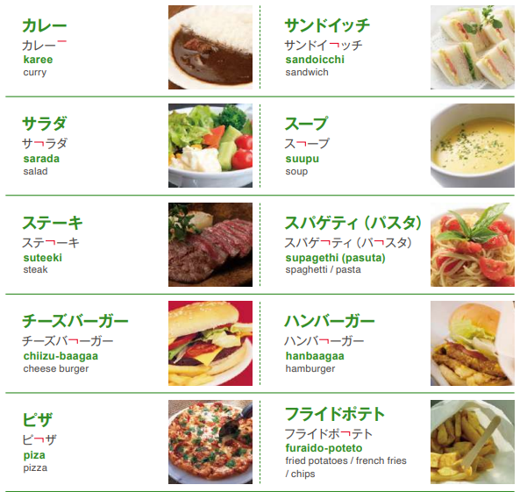
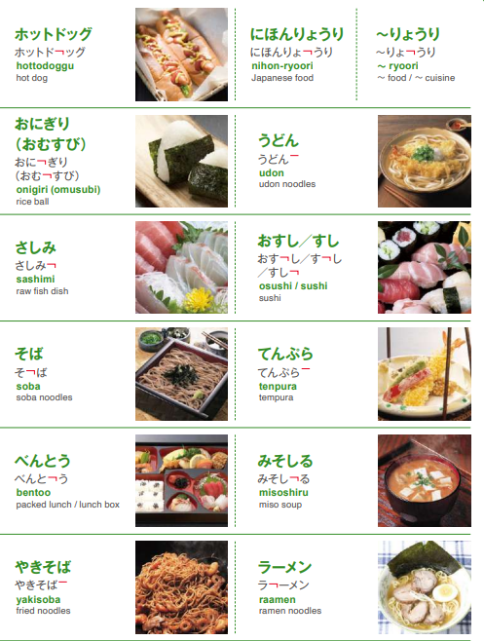
MarugotoStarterWordbook_EN

Slide 8
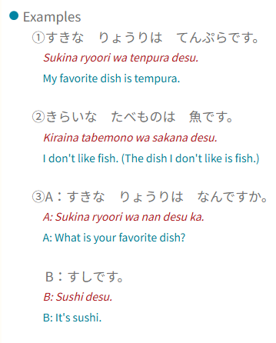

Slide 9
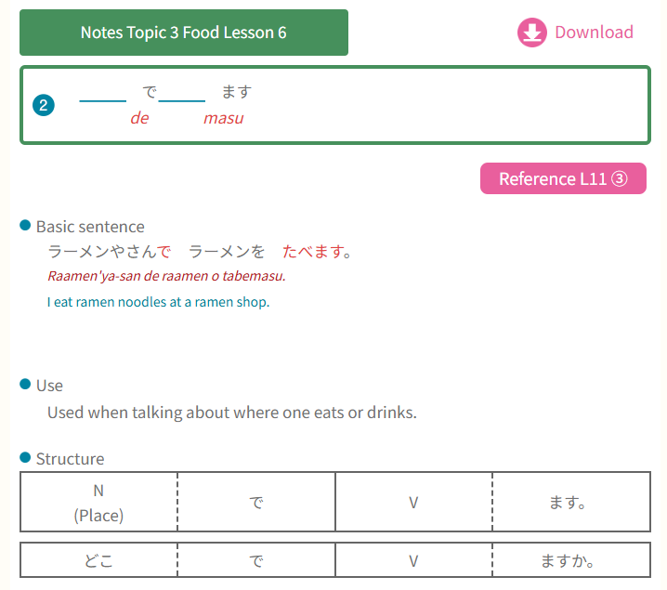
GRAMMAR PART
② Talk about where one eats or drinks
S は Place で O を V ます

Slide 10
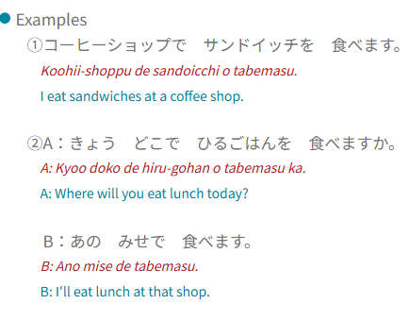
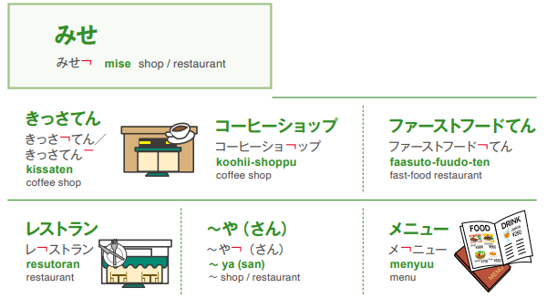
この+noun The noun is near to speaker | これは＿＿＿です
その+noun The noun is far from speaker | それは＿＿＿です
あの+noun The noun is far from both speaker & listener | あれは＿＿＿です

Slide 11
🛒 Explanation: ～てん vs ～や
In Japanese, てんand やboth refer to shops, but they have subtle differences in usage:
てん is more formal and commonly used for larger or established businesses, including department stores, chain stores, and branches. For example:
  百貨店 (ひゃっかてん)** – Department store
  横浜店 (よこはまてん)** – Yokohama branch of a store
や is often used for smaller, independent shops or places that emphasize the character of the owner or the type of goods sold. For example:
  魚屋(さかなや) – Fish shop
  八百屋 (やおや) – Greengrocer
  ラーメン屋 (らーめんや) – Ramen shop
Essentially, てん is more neutral and business-like, while や has a more traditional or personal feel. Some shops use や in hiragana for stylistic reasons, like すきや (すきや).

Slide 12
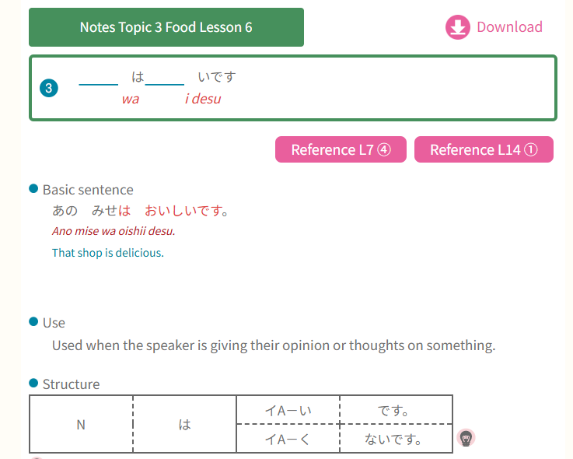
GRAMMAR PART
③ Give opinion, thoughts or
description on something

Slide 13
い - adj | な - adj
i – adjective The bread is delicious パンはおいしいです | na – adjective The cake is beautiful ケーキはきれいです
Ends with い (i) I eat delicious bread おいしいパンをたべます | Needs な (na) before nouns I buy a beautiful cake きれいなケーキをかいます
Conjugation: おいしい → おいしいです + おいしい → おいしくないです – おいしい → おいしくて | Conjugation: きれい → きれいです + きれい → きれいじゃないです – きれい → きれいで
Japanese adjectives: https://www.busuu.com/en/japanese/adjectives

Slide 14
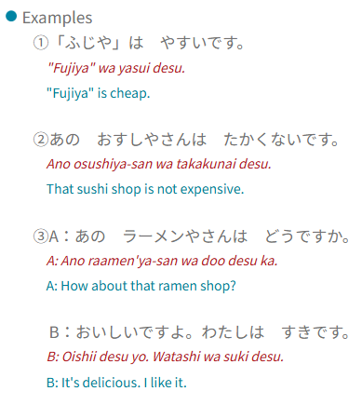
ポスターをつくりましょう
Let’s create a poster
Theme : わたしのすきなたべもの・りょうり
Instruction : Please create a poster about your favorite food/dish. Create at least 3 sentences to introduce the food/dish. For example;
わたしのすきなたべものはケーキです
すきなケーキはチーズケーキです。
チーズケーキはおいしいです。
Submit your poster on Spectrum in PDF format

Slide 15


